Slide 1
SC1015 Mini Project:
Big Mac Prices Prediction
Big Data
FCEA Group 1:
Liu Yanzhi, Lim Zheng Hao, James Megadyanto

Slide 2
Table of Content
Insights & Recommendation
Introduction
Data Preparation
Data Analysis
Practical Motivation and Problem formulation
Datasets collection and cleaning
Exploratory data analysis and visualization.
Machine learning.
Multivariate linear regression model and Future Prediction

Slide 3
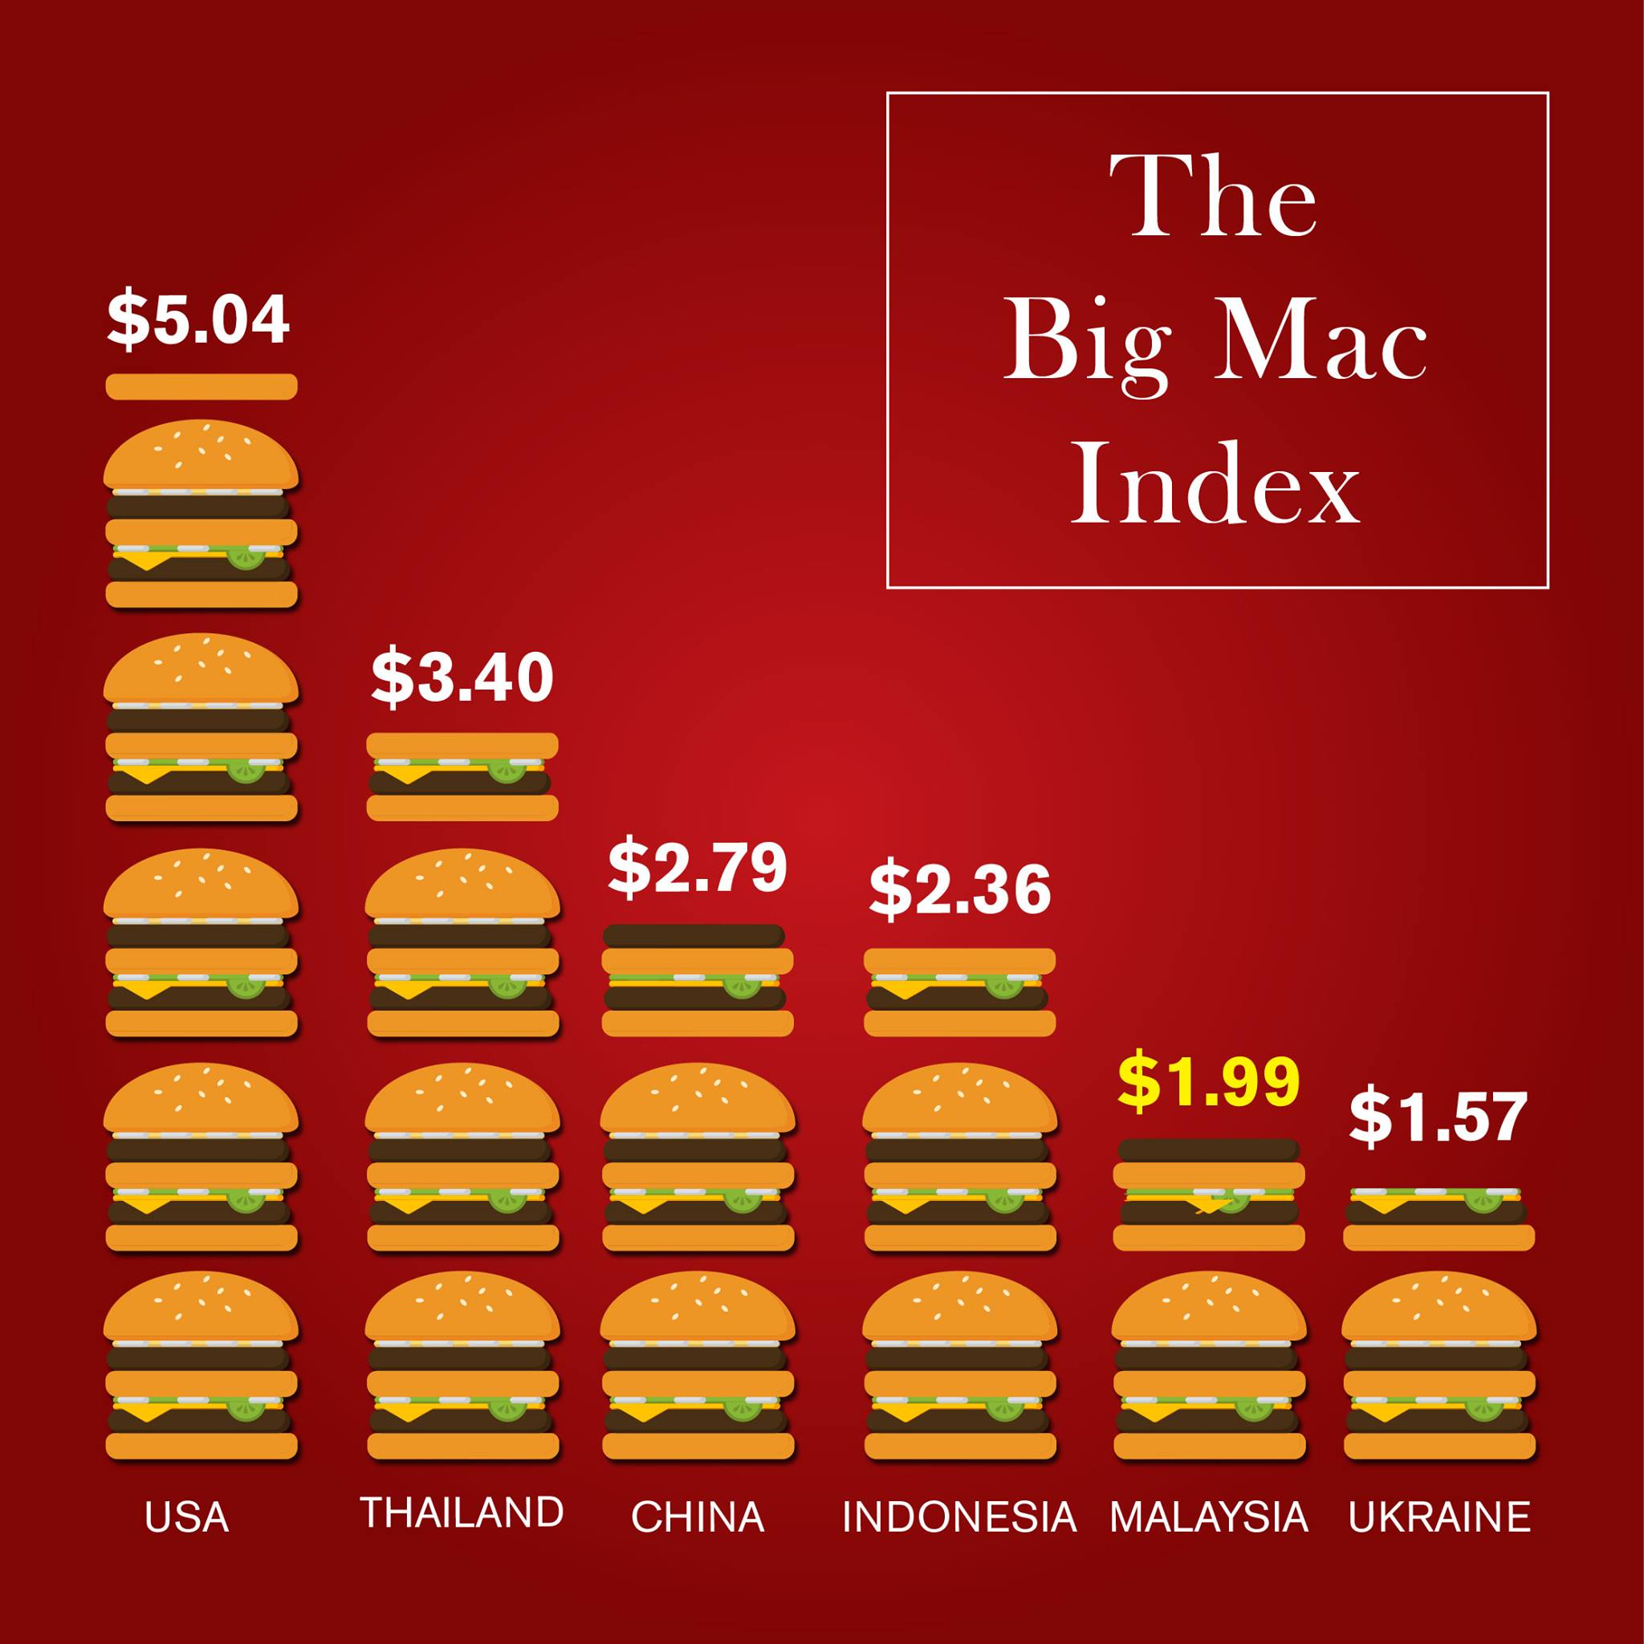
Problem Formulation
Practical Motivation:
The goal of this project is to develop a predictive model that can estimate the local price of a Big Mac in USD across different countries for a given future year. This estimation helps in understanding the economic condition, purchasing power, and potential currency valuation discrepancies in various regions. By predicting Big Mac prices, we can gain insights into the affordability and economic stability of different countries. This analysis can also aid in strategic pricing, currency valuation, and policy evaluation for potential investors and businessmen.
.
Notes:
https://www.facebook.com/My.McDonalds/photos/do-you-know-about-the-big-mac-index-in-1986-the-economist-started-using-the-big-/10157560174500023/

Slide 4
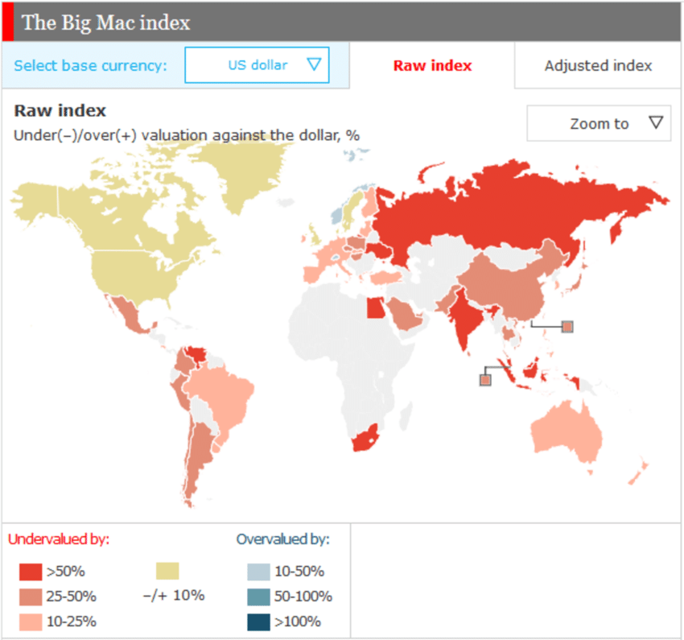
Problem Statement
How the local Big Mac prices are affected by the Purchasing Power Parity (PPP), exchange rate, the average gold price, and inflation rate in their country as well as the year and country.

Slide 5

Datasets Used
https://www.kaggle.com/datasets/mrmorj/big-mac-index-data
https://www.kaggle.com/datasets/yafethtb/gold-price-historical-data-1969-2022
https://www.kaggle.com/datasets/sazidthe1/global-inflation-data?resource=download
https://data.oecd.org/conversion/purchasing-power-parities-ppp.htm#indicator-chart

Slide 6
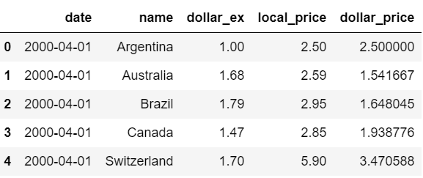
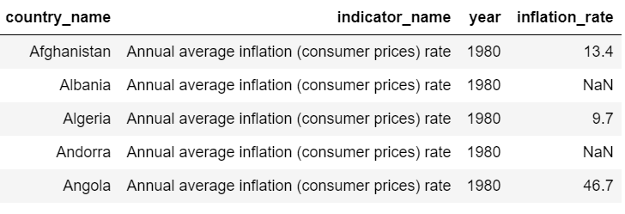
Data Preparation
Convert the Big Mac data, Gold Price Data, PPP, Inflation Rate data into dataframe
Extract the necessary columns
Reformat some of the columns, such as date and prices
Rename the columns
Remove duplicate and NULL data.
Merge all the datasets together

Slide 7
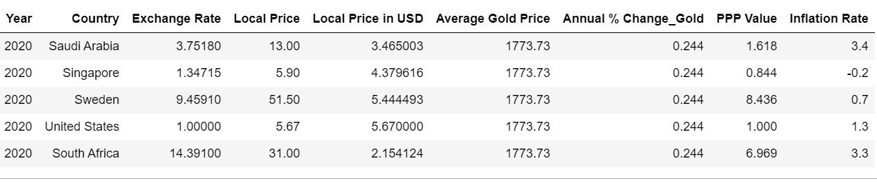
Data Preparation
Columns to keep:
Year
Country
Exchange Rate
Local Price
Local Price in USD
Average Gold Price
Annual % Change_Gold
PPP Value
Inflation Rate

Slide 8
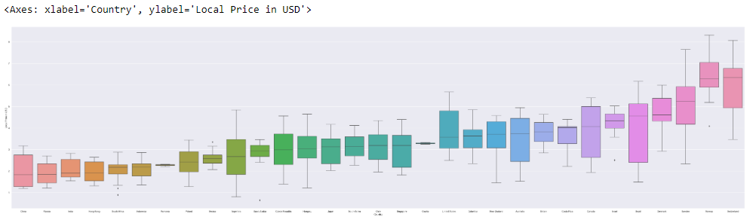
Data Analysis
Using boxplot to check if the Categorical variable, "Country" is a good predictor for Big Mac Prices
"Local Price in USD" against "Country": the distribution of all Big Mac prices from 2000 to 2020 for each of the countries.

Slide 9
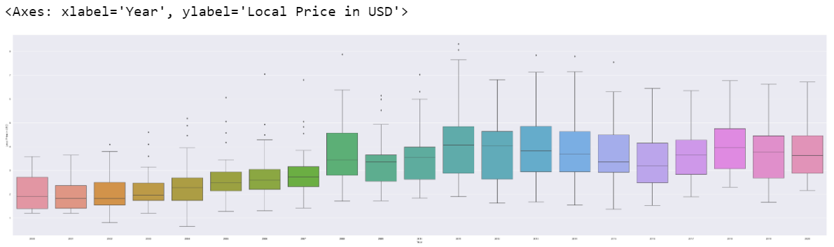
Data Analysis
Using boxplot to check if Continuous variable, "Year" is a good predictor for Big Mac Prices
"Local Price in USD" against "Year": the distribution of the local Big Mac price (in USD) in all the countries for every year from 2000 to 2020

Slide 10
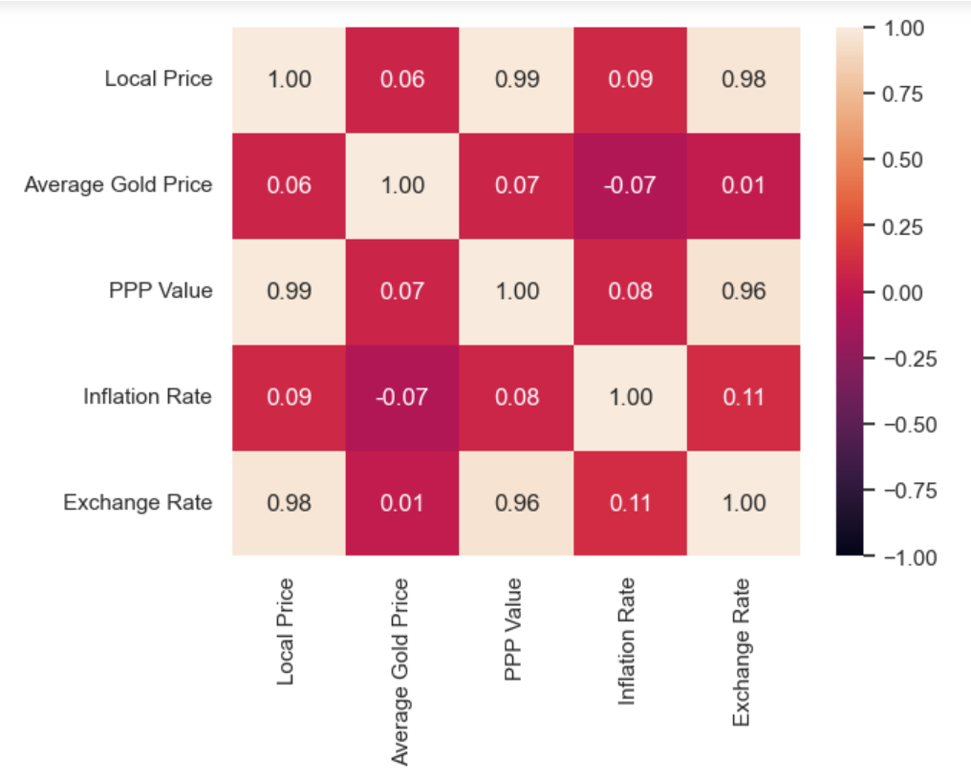
Data Analysis
Plot a heatmap to visualise correlation between numerical variables
The correlation of local Big Mac price to PPP is extremely high, while being almost non-existent for the average gold price and inflation rate. We also found that exchange rate has extremely high correlation.
As such, we will only use PPP, exchange rate, year and country for predicting local Big Mac prices and drop the rest of the irrelevant columns.

Slide 11
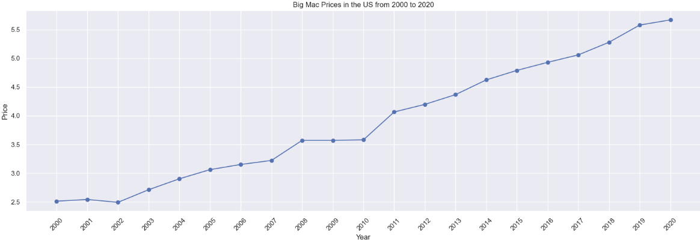
Data Visualization
How Big Mac prices change from 2000 to 2020 in the US.
Local Big Mac prices can change over the years and it is a good variable to be used as a response

Slide 12
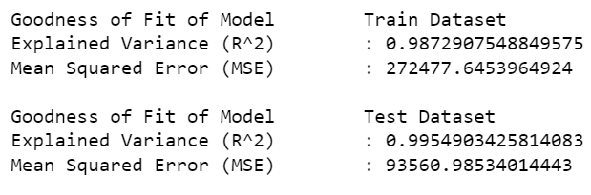
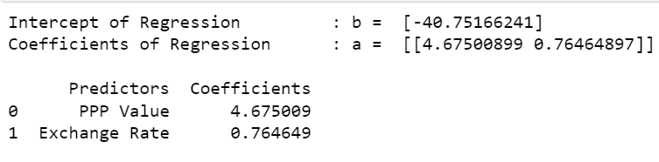
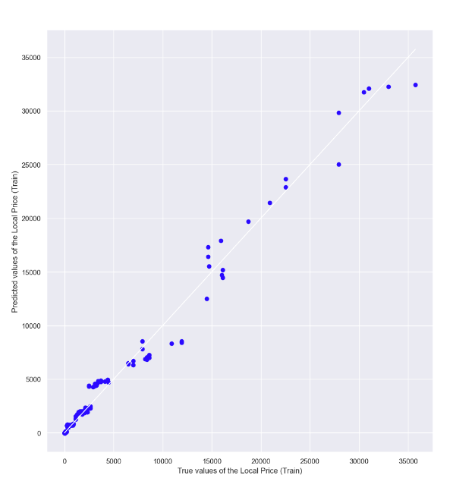
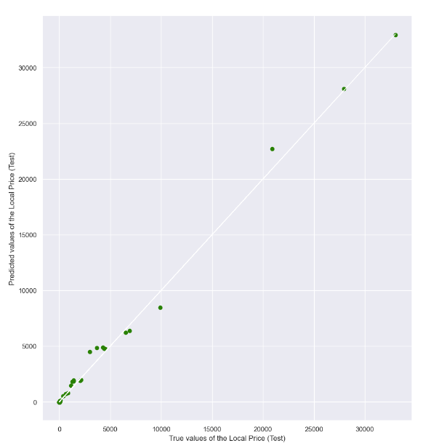
Linear Regression Model
Make a multivariate linear regression model to determine the goodness of fit of PPP and exchange rate alone

Slide 13
Linear Regression Model
As we can see, the Explained Variance is very high while the Mean Squared Error (MSE) is also high:
The model is good enough to predict Local Price.
However, there is still room for improvement to lower the MSE, so we shall see if including the "Year" and "Country" variables can improve it.

Slide 14
Multivariate Linear Regression Model
Response Variable : Local Price
Predictor Feature : Year, Country, Exchange Rate, PPP
Regression Model : Local Price = 𝑎1 x Year + 𝑎2 × Country + 𝑎3 × Exchange rate + 𝑎4 x PPP + 𝑏

Slide 15
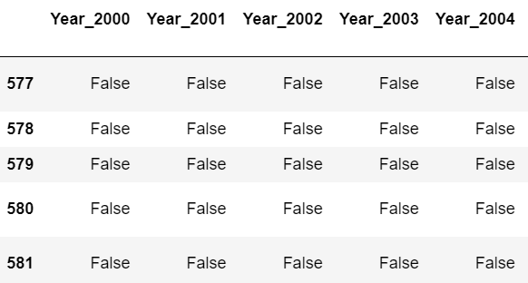
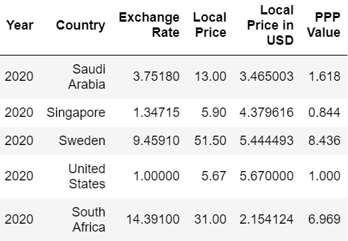
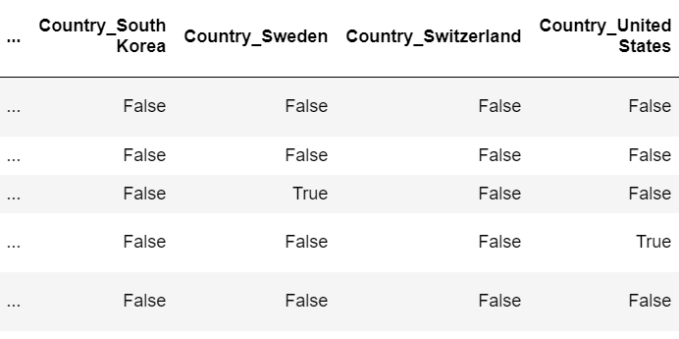
Encode Year and Country
Encode Country and Year using one-hot encoding as we want to compare different years and countries as distinct categories.

Slide 16
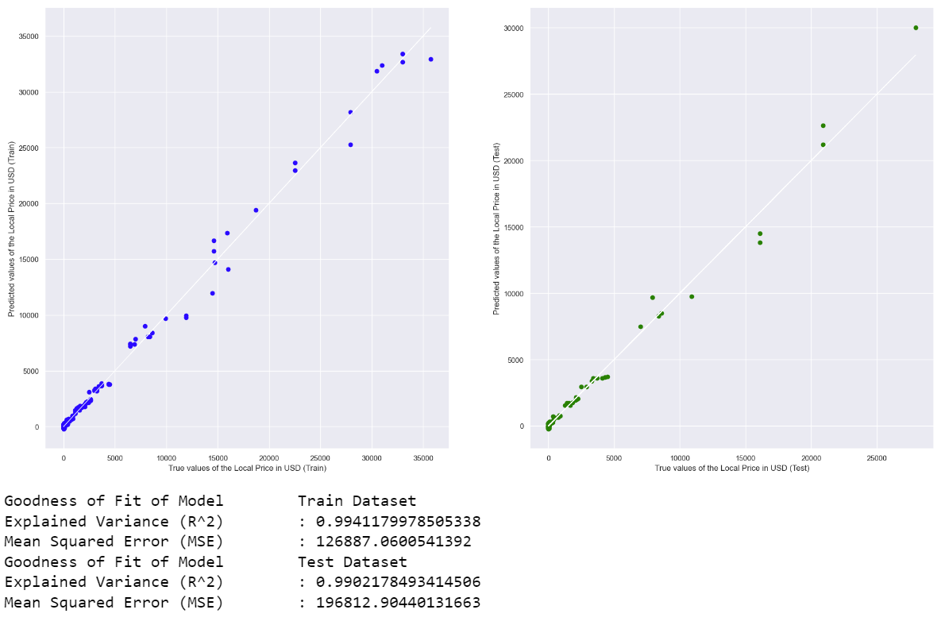
Multivariate Linear Regression Model
Using PPP, Exchange Rate, the various Years and Countries as the predictors and Local Price as the Response variable

Slide 17
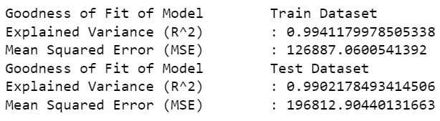
Multivariate Linear Regression Model
From the above model, we can see that there is indeed an improvement in both the R^2 and MSE:
R^2 increasing
MSE decreasing for both the train and test datasets
Fig 1. PPP + Exchange rate
Fig 2. PPP + Exchange rate + Country + Year

Slide 18
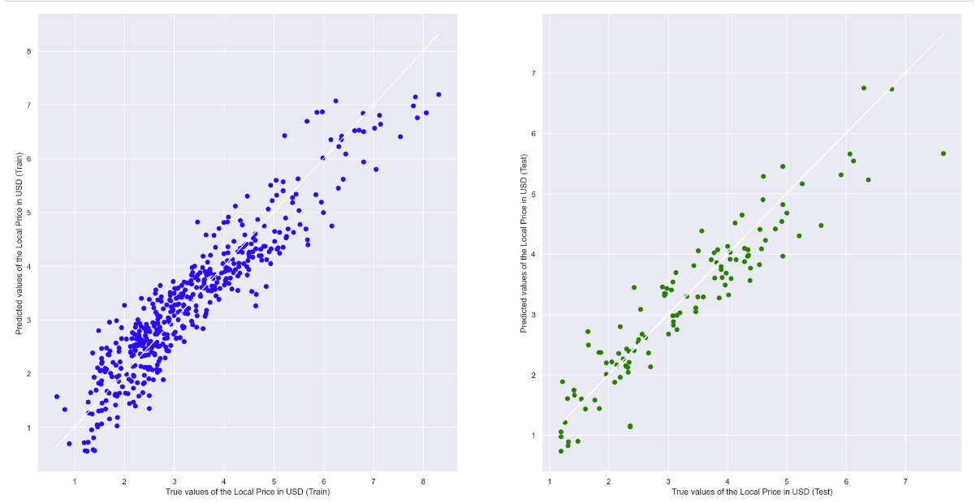
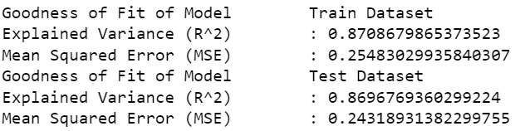
Multivariate Linear Regression Model (USD)
To ensure consistency in currency, we plan to predict the Local Price of a Big Mac in USD.
Predictors: PPP, Exchange Rate, the various Years and Countries
Response: Local Price in USD

Slide 19
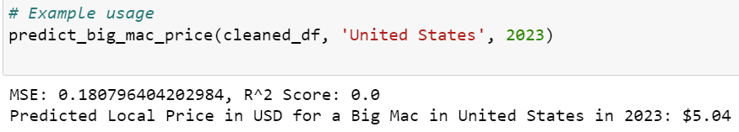
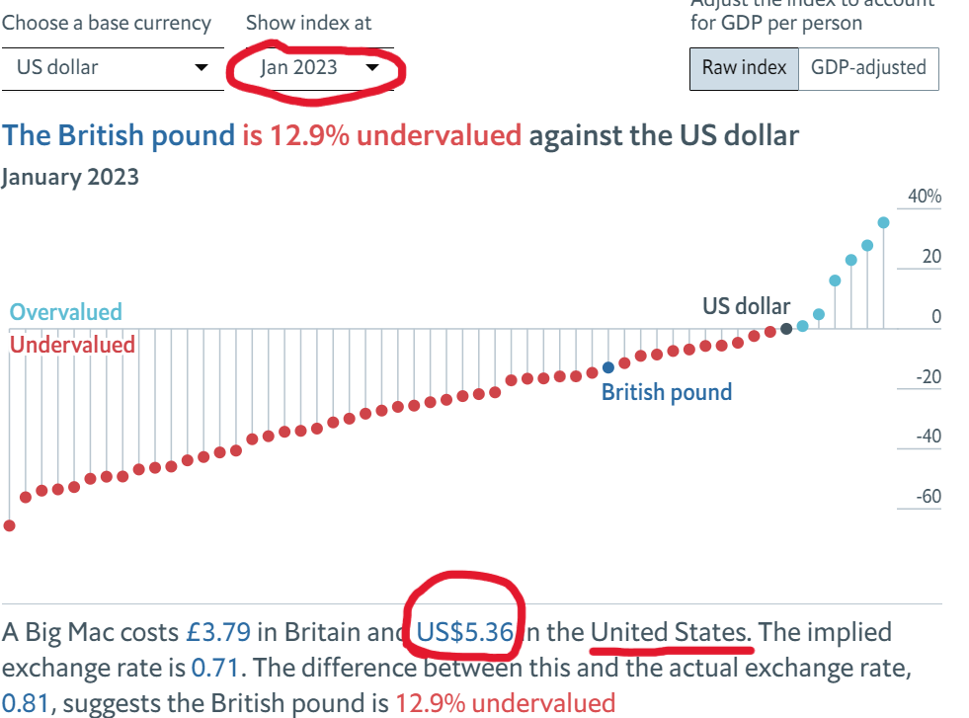
Prediction of Big Mac Local Price
For example in the above, we were able to predict the Local Price in USD for a Big Mac in the US in 2023 using the variables in the 2nd model quite accurately. The function above uses the PPP and Exchange Rate values from the past 10 years of the input year to make this prediction

Slide 20
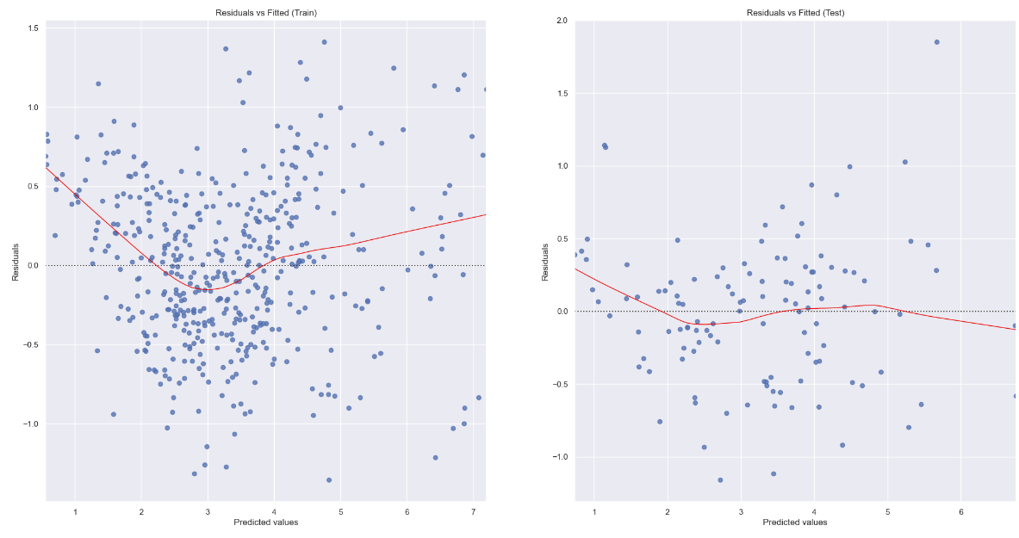
Improvement and Recommendation:
We use a residual plot to assess the goodness-of-fit of the regression model

Slide 21
The residual plot shows a random scatter of points around the horizontal axis with no obvious pattern which suggests that the relationship between the independent variables and the dependent variable is linear
There isn't a consistent spread of points along the horizontal axis for the train dataset
For the test dataset however, there is homoscedasticity, which indicates that the variance of the residuals is constant across all levels of the independent variables
There are some curves and bends. This could indicate that a more complex (nonlinear) model might be more appropriate

Slide 22
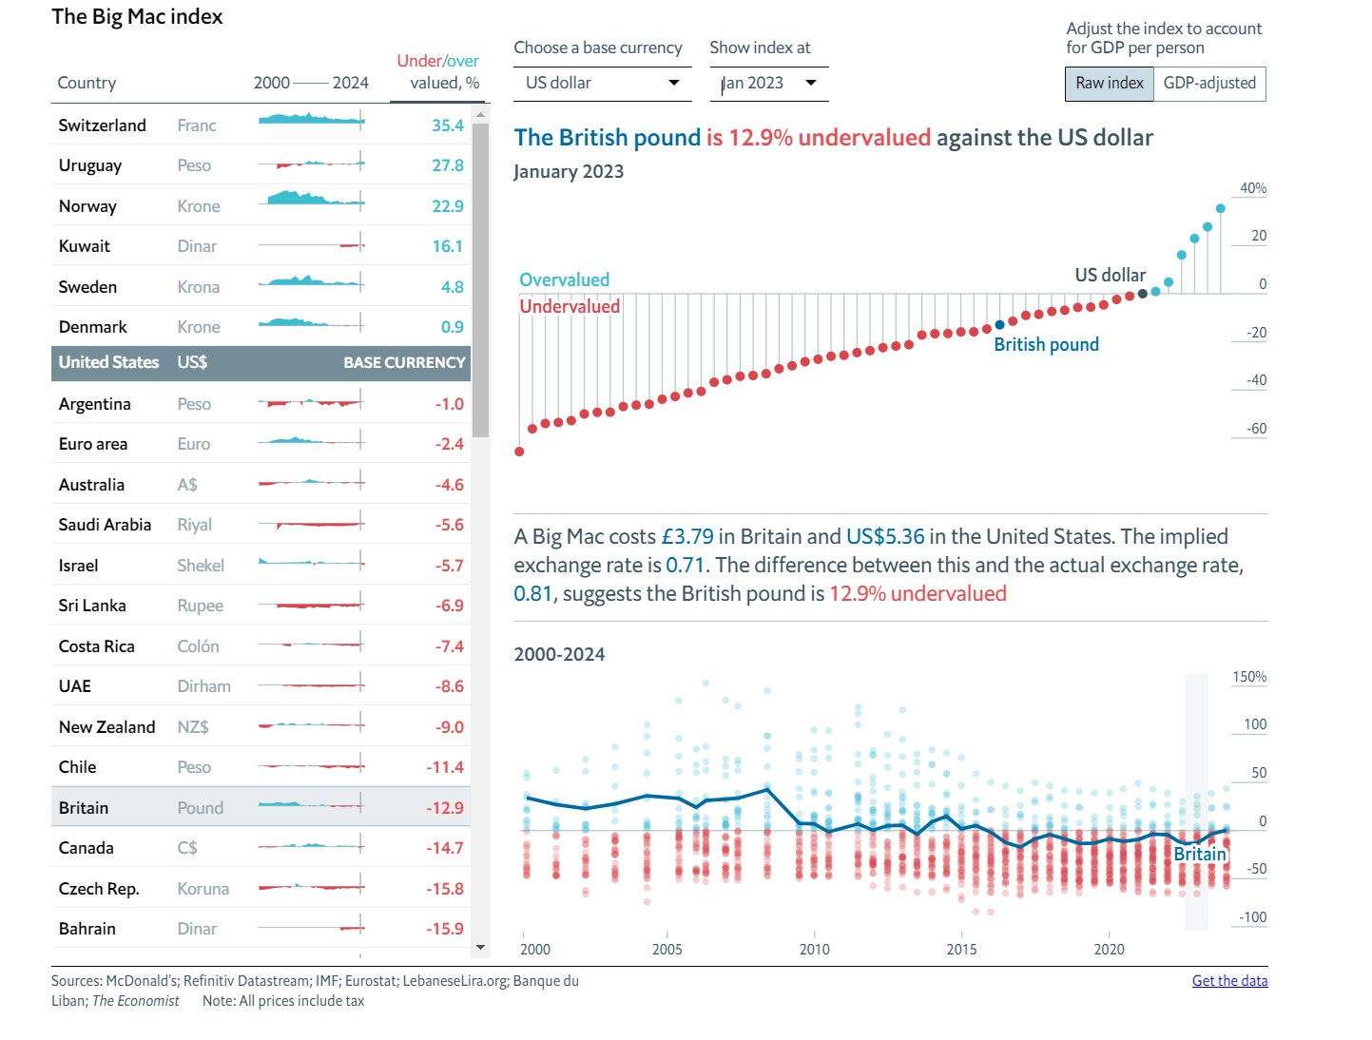
Improvement and Recommendation:
We were able to accurately model the local price of a Big Mac using the year, country, PPP and exchange rate values and accurately predict the local price of a Big Mac in USD in the future using these variables.

Slide 23
Improvement and Recommendation:
For improvements, we could perhaps consider using a non-linear model such as random forest or K-Nearest Neighbors (KNN) or even time-series analysis to model the relationship between local price and PPP, exchange rate, year and country.
We could also analyse other variables that could affect the local price of a Big Mac such as unemployment levels and overall economic growth of a country.

Slide 24
Thank you!

Slide 25
References:
https://www.facebook.com/My.McDonalds/photos/do-you-know-about-the-big-mac-index-in-1986-the-economist-started-using-the-big-/10157560174500023/
Burgernomics: An Instructional Case on the Law of One Price - Scientific Figure on ResearchGate. Available from: https://www.researchgate.net/figure/World-map-showing-the-currency-misalignments-according-to-the-Big-Mac-Index_fig1_282666058 [accessed 23 Apr, 2024]
https://www.economist.com/big-mac-index

Slide 26
Big Data Infographics
Insight 1
Mercury
Planet Mercury is the smallest one in the entire Solar System
Mars
Despite being red, Mars is actually a cold place full of iron oxide dust
90%
70%
40%
Jupiter
Mercury
Mars
Jupiter
90%
70%
40%
Planet Jupiter is a gas giant and the biggest one in the Solar System
Insight 2

Slide 27
Big Data Infographics
01
Volume
Jupiter is the biggest planet of them all
04
Veracity
02
Earth is the planet where we live on
Velocity
5 Vs of Big Data
Venus is the second planet from the Sun
05
Value
03
Mercury is the closest planet to the Sun
Variety
Despite being red, Mars is a cold place

Slide 28
Big Data Infographics
Mars
Despite its reddish cast, it’s actually an incredibly cold place
50%
70%
80%
Mercury
Mercury is the closest planet to the Sun and the smallest one of them all
700$
400$
800$
500$
2017
Saturn
2018
Saturn is a planet composed mostly of hydrogen and helium, and has rings
2019
2020

Slide 29
Big Data Infographics
Low Volume
High Volume
Mercury is the closest planet to the Sun
Jupiter is the biggest of them all
Batch
Small Data vs. Big Data
Real-Time
Despite being red, Mars is a cold place
Venus is the second planet from the Sun
Structured
Multi-Structured
Earth is the planet where we live on
Saturn is the ringed one. It’s a gas giant

Slide 30
Big Data Infographics
Volume
50%
Venus has a beautiful name and is the second one from the Sun
Variety
60%
Mercury is the closest planet to the Sun and the smallest one
Veracity
75%
Despite being red, Mars is a cold place full of iron oxide dust
Value
70%
Jupiter is a gas giant and the biggest planet of them all

Slide 31
Big Data Infographics
Despite being red, Mars is actually a cold place
Value
Mercury is the smallest planet in the Solar System
Veracity
Earth is the third planet from the Sun and the one with life
Variety
Neptune is the farthest planet from the Sun and a gas giant
Velocity
Jupiter is a gas giant and the biggest planet of them all
Volume

Slide 32
Big Data Infographics
Data 1
Data 2
01
Mercury is the smallest planet in the Solar System
02
Mars is actually a cold place, it’s full of iron oxide dust
40%
80%
03
Jupiter is a gas giant and the biggest of them all
04
Saturn is composed of hydrogen and helium
60%
30%
70%
55%
55%
35%

Slide 33
Big Data Infographics
01
Mercury is the closest planet to the Sun
Volume
02
Venus is the second planet from the Sun
Velocity
4 Vs of Big Data
03
Jupiter is a gas giant and the biggest planet
Veracity
04
Yes, this is the ringed one. It’s a gas giant
Variety

Slide 34
Big Data Infographics
Venus
Venus has a beautiful name and is the second planet from the Sun
Data 1
70%
35%
70%
35%
Mercury
Mercury is the closest to the Sun and the smallest one
50%
Mars
65%
Despite being red, it’s a cold place. It’s full of iron oxide dust
Data 2
60%
Jupiter
Jupiter is a gas giant and the biggest planet in the Solar System
40%

Slide 35
Instructions for use (free users)
In order to use this template, you must credit Slidesgo by keeping the Thanks slide.
You are allowed to:
Modify this template.
Use it for both personal and commercial purposes.
You are not allowed to:
Sublicense, sell or rent any of Slidesgo Content (or a modified version of Slidesgo Content).
Distribute this Slidesgo Template (or a modified version of this Slidesgo Template) or include it in a database or in any other product or service that offers downloadable images, icons or presentations that may be subject to distribution or resale.
Use any of the elements that are part of this Slidesgo Template in an isolated and separated way from this Template.
Delete the “Thanks” or “Credits” slide.
Register any of the elements that are part of this template as a trademark or logo, or register it as a work in an intellectual property registry or similar.
For more information about editing slides, please read our FAQs or visit Slidesgo School:
https://slidesgo.com/faqs and https://slidesgo.com/slidesgo-school

Slide 36
Instructions for use (premium users)
In order to use this template, you must be a Premium user on Slidesgo.
You are allowed to:
Modify this template.
Use it for both personal and commercial purposes.
Hide or delete the “Thanks” slide and the mention to Slidesgo in the credits.
Share this template in an editable format with people who are not part of your team.
You are not allowed to:
Sublicense, sell or rent this Slidesgo Template (or a modified version of this Slidesgo Template).
Distribute this Slidesgo Template (or a modified version of this Slidesgo Template) or include it in a database or in any other product or service that offers downloadable images, icons or presentations that may be subject to distribution or resale.
Use any of the elements that are part of this Slidesgo Template in an isolated and separated way from this Template.
Register any of the elements that are part of this template as a trademark or logo, or register it as a work in an intellectual property registry or similar.
For more information about editing slides, please read our FAQs or visit Slidesgo School:
https://slidesgo.com/faqs and https://slidesgo.com/slidesgo-school

Slide 37
Infographics
You can add and edit some infographics to your presentation to show your data in a visual way.
Choose your favourite infographic and insert it in your presentation using Ctrl C + Ctrl V or Cmd C + Cmd V in Mac.
Select one of the parts and ungroup it by right-clicking and choosing “Ungroup”.
Change the color by clicking on the paint bucket.
Then resize the element by clicking and dragging one of the square-shaped points of its bounding box (the cursor should look like a double-headed arrow). Remember to hold Shift while dragging to keep the proportions.
Group the elements again by selecting them, right-clicking and choosing “Group”.
Repeat the steps above with the other parts and when you’re done editing, copy the end result and paste it into your presentation.
Remember to choose the “Keep source formatting” option so that it keeps the design. For more info, please visit Slidesgo School.

